Slide 1





Centrality Analysis of Cryptocurrency Transaction Networks Based on the Elliptic Dataset
Zhenyu Yang
Jinshan Xu
Longchen Sima
Qiuyue Jin
Jialin Chen
School of Economics, Xiamen University

Slide 2
Outline
1.Background
2.Technical Introduction
3.Results Analysis
4.Summary

Slide 3
Background
Industry Pain Points
Blockchain’s decentralization facilitates illicit transactions and money laundering, making AML detection in crypto networks essential for financial supervision. Centralized key nodes can cause system-wide risk propagation via abnormal behaviors.
Research Gap
Tree-based models and GNN are mainstream AML approaches with different advantages in feature learning and graph adaptability, but their comparative evaluation in real blockchain transactions is still limited.

Slide 4
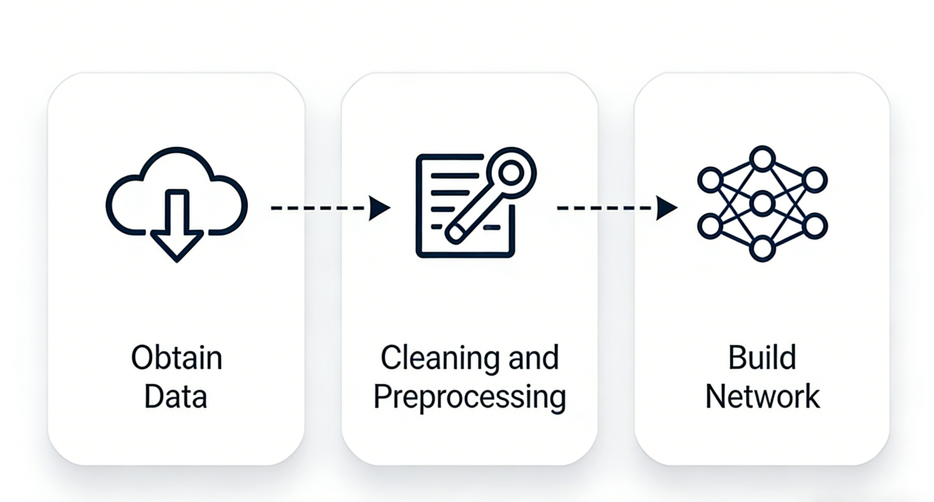
Technical Introduction：data processing
Our research leverages the Elliptic++ dataset (200k+ Bitcoin transactions, 230k+ edges) with a three-step processing pipeline:
Acquisition & Preprocessing
Obtain raw data, perform cleaning, deduplication, and handle missing values for quality assurance.
Network Construction
Model transactions as nodes and fund flows as directed edges to build a complete transaction graph.
Feature Extraction
Utilize 166 native features and compute network centrality metrics to enrich feature space.

Slide 5
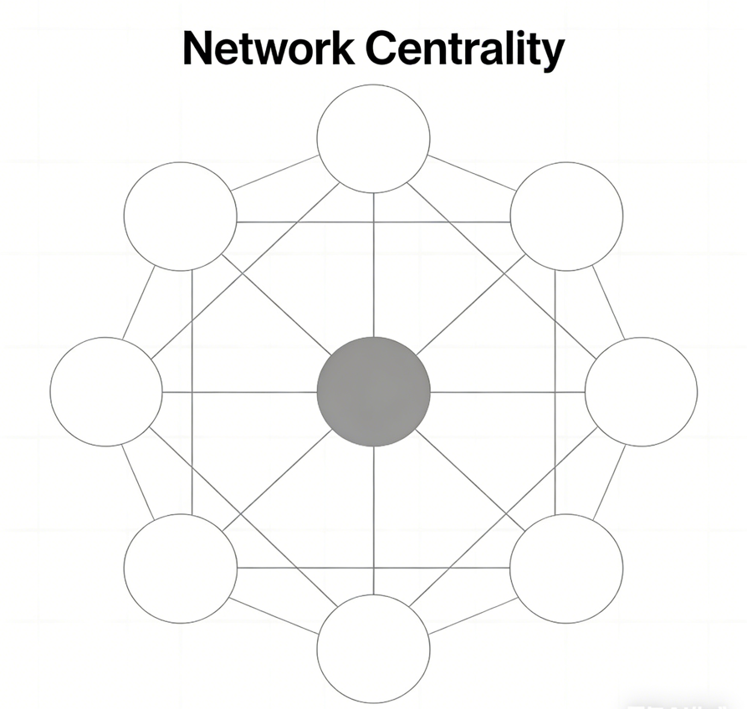
Technical Introduction：Centrality Metrics
Degree centrality
In-degree/Out-degree Ratio
PageRank centrality
Betweenness centrality
Closeness Centrality
Clustering Coefficient

Slide 6
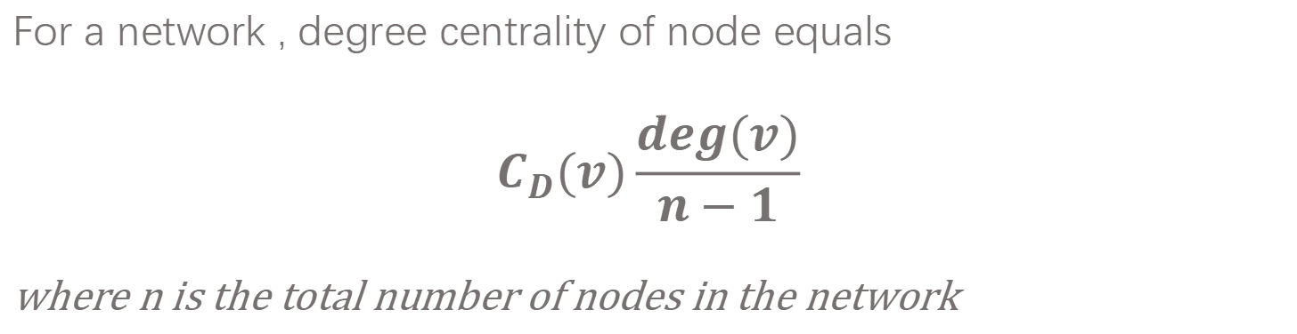
Degree centrality
Nieminen (1974): Measure of centrality based upon degree.
For a network , degree centrality of node equals
For a network , degree centrality of node equals
$$C_{D}(v)\frac{deg(v)}{n−1}$$
where n is the total number of nodes in the network

Slide 7
In-degree/Out-degree Ratio
Core Logic: Distinguish inward/outward capital flow in directed graphs.
Project Significance:
High out-degree & low in-degree → Money laundering distribution end (early stage)
High in-degree & low out-degree → Aggregation end / Darknet receiving address

Slide 8

PageRank centrality
PageRank centrality of node $v_{k}$:
$$C_{PR}(v_{k})=α\sum_{i=1}^{n}{\frac{a_{k,i}}{d(v_{i})}}C_{PR}(v_{i})+β$$
where $α$ and $β$ : constants
and $d(v_{i})$ : out-degree of node $v_{i}$ if such degree is positive, or $d(v_{i})=1$ if the out-degree of $v_{i}$ is null.

Slide 9
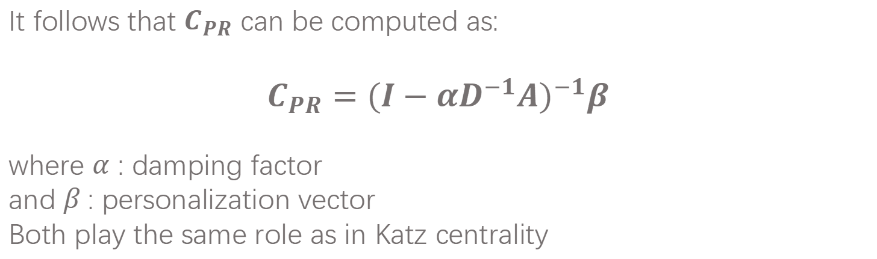
PageRank centrality
It follows that $C_{PR}$ can be computed as:
$$C_{PR}={(I−αD^{−1}A)}^{−1}β$$
where $α$ : damping factor
and $β$: personalization vector
Both play the same role as in Katz centrality

Slide 10

Betweenness centrality
Core Logic: Nodes acting as "bridges" more frequently are more important. Measures the control over information flow.
Mathematical Expression: Ratio of shortest paths passing through the node in the entire network.
$$C_{B}(v)=\sum_{s≠v≠t}{\frac{σ_{st}(v)}{σ_{st}}}$$
where
$σ_{st}$: Total number of shortest paths from node s to node t
$σ_{st}(v)$: Number of such paths passing through node v

Slide 11

Closeness Centrality
Core Logic: Measures the average distance from a node to all other nodes in the network.
Mathematical Expression: closeness centrality equals
$$C_{C}(v_{k})=\frac{1}{\sum_{i=1}^{n}{d(v_{i},v_{k})}}$$
where :$d(v_{i},v_{k})$: of edges in the geodesic linking $v_{i}$, $v_{k}$
Relative centrality based on closeness measure:
$$C_{C}^{’}(v_{k})=\frac{n−1}{\sum_{i=1}^{n}{d(v_{i},v_{k})}}$$

Slide 12
Clustering Coefficient
Core Logic: Measures if a node's neighbors are connected to each other (clustering degree).
Project Significance:
Illicit nodes (especially money laundering ones) have extremely low clustering coefficients.
To avoid tracking, funds are transferred linearly instead of circulating among associates.
An excellent indicator for identifying the "distribution-type" money laundering mode.

Slide 13
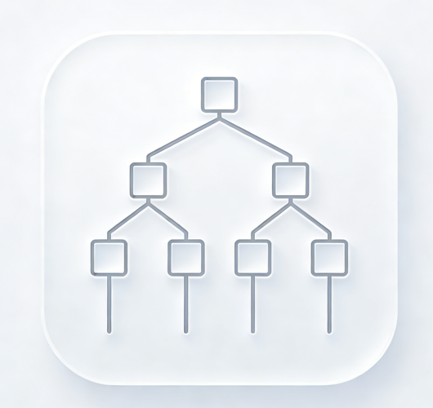
Technical Introduction：Model Training
From "Forest" to
"Gradient Boosting" & "Graph Structure"
LightGBM (Leaf-wise)
GraphSAGE GNN (F1-optimized parameters)
GNN + Optuna hyperparameter search

Slide 14
LightGBM (Leaf-wise)
Background: Efficient GBDT implementation, core tree growth strategy, baseline model for blockchain AML detection
Core Growth Logic
Criterion: Max loss function reduction
Split only the leaf node with the largest split gain
Limit depth/leaf num to avoid overfitting
Three Lightweight Core Technologies
Histogram Optimization：Discretize continuous features, reduce memory/computation
GOSS：Retain high-gradient samples, precise down-sampling
EFB：Bundle mutually exclusive features, reduce high-dimensional feature dimensions

Slide 15
GNN — Graph Neural Network
Core idea:
learn embeddings by aggregating features from a node and its neighbors.
GNN is a type of neural network for graph-structured data, which consists of nodes and edges, such as blockchain transaction networks, fund flows, and social relations.Effectively captures structural patterns, relationships, and propagation paths, ideal for money laundering detection, fraud identification, and ring discovery.
Common models:
GraphSAGE, GCN, GAT, GIN, etc.

Slide 16

GNN — Graph Neural Network
F1-optimized parameters
The best set of model parameters optimized to maximize F1-score, for imbalanced tasks like AML detection.
$F_{1}=2∗\frac{Precision∗Recall}{Precision+Recall}$
Optuna hyperparameter search
An automatic parameter searching process using Optuna to find the best hyperparameters.

Slide 17
Technical Introduction：Voting & Analysis
From "Simple Majority" to "Weighted Interpretation"
Soft Voting
Outputs probabilities instead of classes.
Averages weighted probabilities from multiple models.
More robust and accurate than hard voting.
Shapley Additive Explanations
Game theory-based model explanation method.
Quantifies feature importance for each prediction.
Improves transparency and interpretability.

Slide 18
Results Analysis
Data Structure
Network Feature Analysis
Model Architecture
Performance Comparison

Slide 19
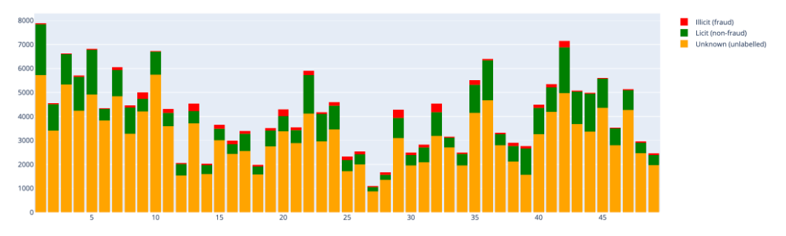
Results Analysis：Data Structure
Data Structure
The Elliptic dataset contains a total of 200k+ Bitcoin transactions, 230k+ edges, with three types of node labels: illicit, licit, and unknown. The distribution is shown in the figure

Slide 20
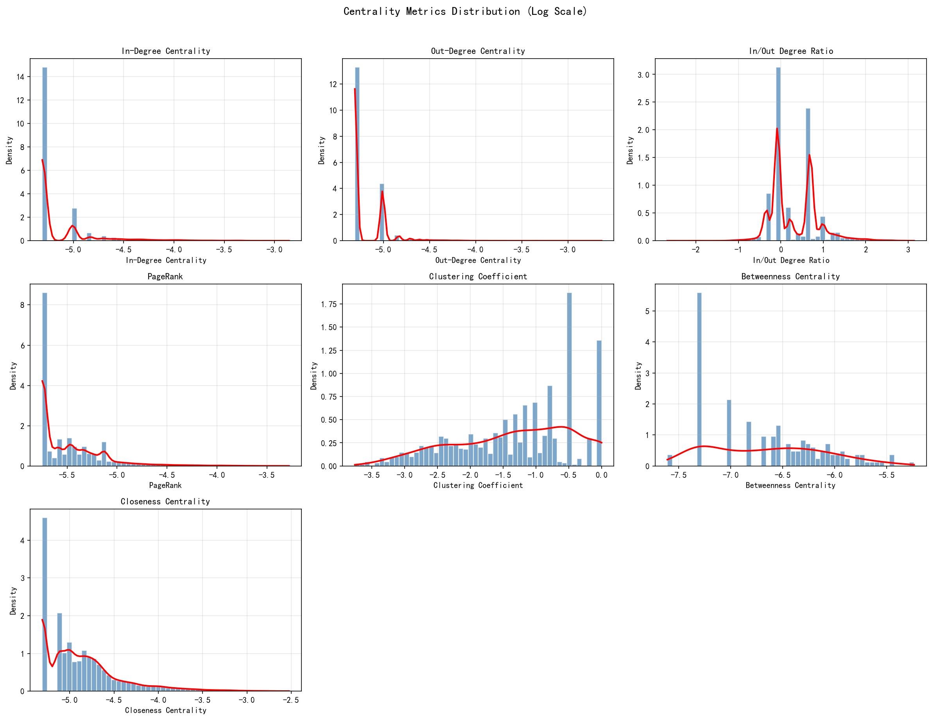
Results Analysis：Network Feature Analysis
Centrality Histograms
Chart Interpretation
Exhibiting typical right-skewed long-tail distributions.

Slide 21
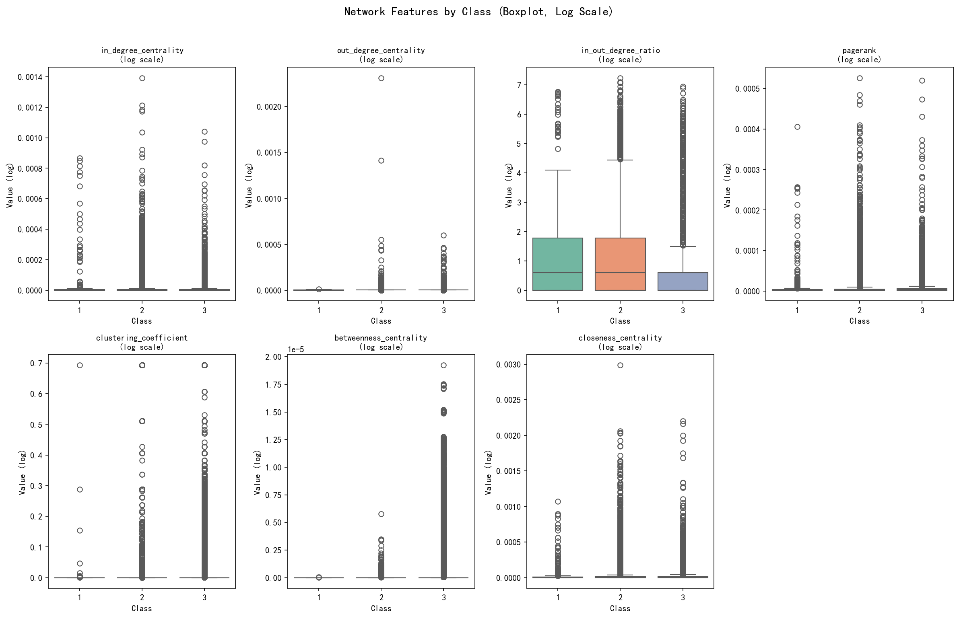
Results Analysis：Network Feature Analysis
Boxplot of 7 network features grouped by class (log scale).
Chart Interpretation
Blue box = Unknown class (3), Green = Licit (2), Red = Illicit (1). Licit nodes show more dispersed feature value distributions, illicit nodes generally have lower and more concentrated feature values.

Slide 22
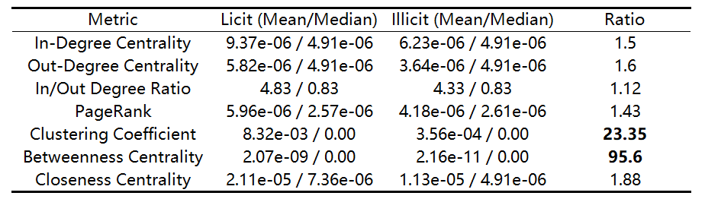
Results Analysis：Network Feature Analysis
Centrality Statistics
Key Findings
Clustering Coefficient Difference: Licit nodes have a clustering coefficient 23x higher than illicit nodes, indicating that licit transactions form tighter local communities (e.g., business networks).
Betweenness Centrality Difference: Licit nodes have betweenness centrality 95x higher than illicit nodes, suggesting licit nodes more often serve as network intermediaries (e.g., exchanges, payment platforms).

Slide 23
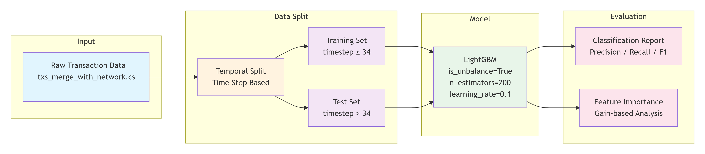
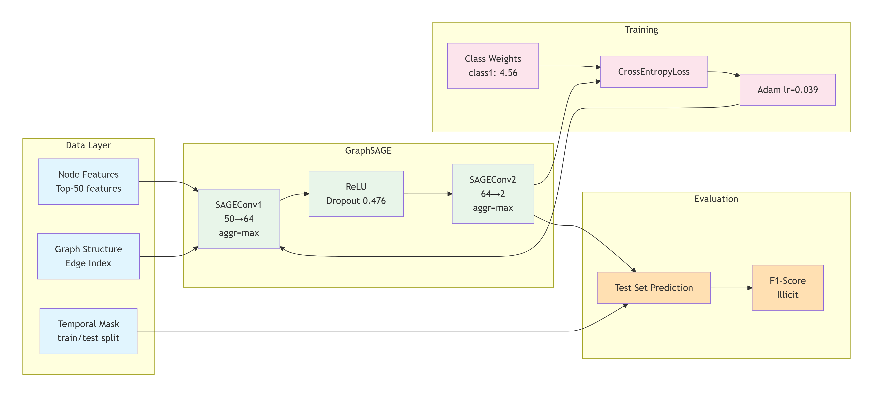
Results Analysis：Model Architecture
LightGBM
GraphSAGE

Slide 24
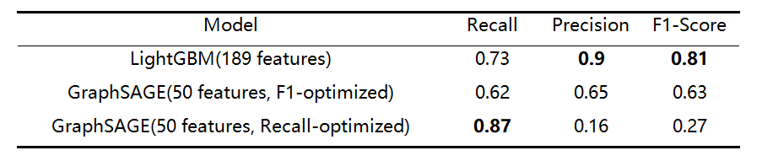
Results Analysis：Performance Comparison
Key Finding
Tree-based models significantly outperform GNN on this task.
Key issues identified:
Unknown node interference: 77% of nodes have unknown labels, contaminating message passing.
Temporal distribution shift: Graph structure evolves over time.
Training strategy: No validation set, no early stopping.

Slide 25
Summary
Conclusion
In the current dataset, LightGBM performs significantly better than GraphSAGE, and simple and effective algorithms have advantages in specific scenarios.
Future Prospects
Optimize training strategy: Introduce validation set and early stop mechanism to prevent overfitting; Exploring Semi Supervised Learning to solve unknown node problems.
Advanced Model Exploration: Attempting Time Graph Neural Networks to capture dynamic evolution.
Data and Feature Engineering: Utilizing GAN to generate samples to alleviate class imbalance and explore deeper network topology feature information.
Hybrid model fusion: Combining LightGBM feature importance with GNN structural information to construct a high-performance hybrid model with complementary advantages.

